Slide 1

Hypothesis testing
DATA ANALYTICS | IRONHACK

Slide 2


HYPOTHESIS TEST
A hypothesis test is an statistical analysis which uses one sample of our population to asses two mutually exclusive theories about the population, named:
Null Hypothesis: Ho
Alternate Hypothesis: Ha
Ho
Ha

Slide 3
ELEMENTS OF HYPOTHESIS TEST
The elements needed to conduct this type of analysis are:
Null hypothesis: Ho
Alternate hypothesis: Ha
Confidence level (1- α ) or significance level ( α )
Test statistic ( value computed the sample, different in every test )
P-value

Slide 4
NULL HYPOTHESIS:
Is one of the two mutually exclusive theories about the population properties.
Typically the Ho means that there is no effect.

Slide 5
ALTERNATE HYPOTHESIS:
The other theory.

Slide 6
CONFIDENCE AND SIGNIFICANCE LEVEL:
Significance level ( α ): How strong the sample evidence must be to conclude that there null hypothesis can be rejected.
Ex: in a criminal court, the null hypothesis is the accused is innocent unless police finds strong enough evidences to reject the null hypothesis,
Confidence level ( 1 - α ): Likelihood of finding a value as extreme as the one we have.

Slide 7
WAYS TO CONDUCT A STATISTICAL TEST:
There are two ways to conduct an statistical test:
Computing the test statistic from our sample and comparing it against the critical value corresponding to a given confidence level.
Comparing the p-value from our sample and comparing it against the significance level.

Slide 8
HYPOTHESIS TESTING USING THE TEST STATISTIC:
Fix the confidence level.
Compute the test statistic.
Compute the critical value of the corresponding distribution.
Compare the test statistic with the critical value.
If the test statistic is in the allowed region, (the allowed region is determined by the confidence level) accept the null hypothesis, otherwise reject the it.
The allowed region depends on the type of test.

Slide 9
HYPOTHESIS TESTING USING THE P-VALUE:
P-VALUE = P( D | HO ) = What is the probability to obtain your data, if the null hypothesis is true.
Set your significance level.
Get your p-value.
Compare your p-value against your significance level alpha.
P-value <= alpha -> reject the null hypothesis
P-value > alpha -> accept the null hypothesis

Slide 10
THE CENTRAL LIMIT THEOREM
We know that according to this theorem, the the sampling distribution follows a normal distribution centered around the population mean ( regardless of the original population distribution)
Therefore, if we subtract the mean of our sample from the population mean, the resulting values will follow a normal distribution centered on 0. ( If we subtract two random variables which follow a normal distribution, the resulting value follows a normal distribution )
If we divide the previous values by the standard error of the mean, then the resulting distribution will be a normal distribution with mean = 0 and standard deviation = 1

Slide 11
THE CORE IDEA OF HYPOTHESIS TESTING
We know that the means of the samples, follow a normal distribution.
The mean of a sample is almost never equal to the population mean. This difference is called sampling error.
We can use this fact in order to evaluate how likely is to get a sample with a mean which deviates from the population mean as much as the sampling error.
Based on the probability of getting the sampling error we will decide if we accept or reject the null Hypothesis.
For that, we will have to set how unlikely should be to get a sampling error to reject the null hypothesis.

Slide 12
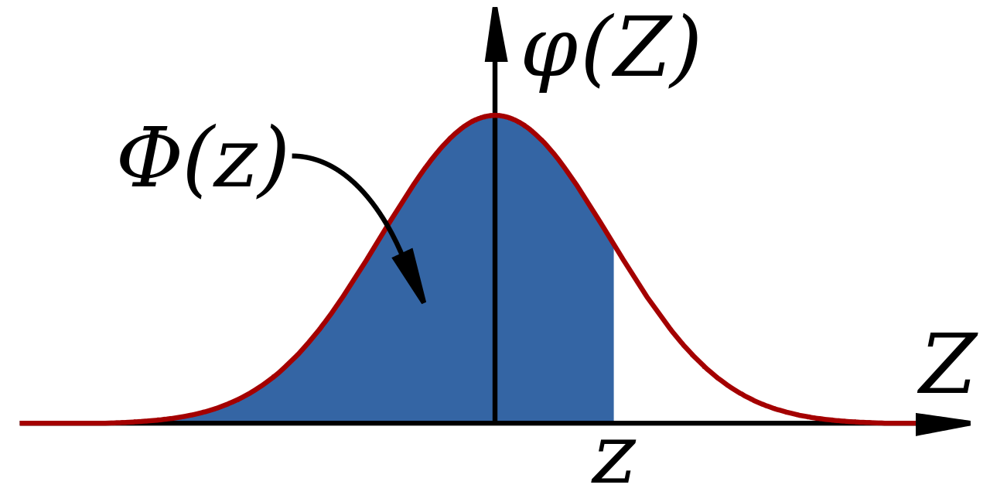
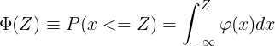
CUMULATIVE DISTRIBUTION FUNCTION: CDF
This function gives the probability to get ANY value below or equal to a given one ( confidence level = 1- α ) (significance level = α ) for a given distribution.
1- α
α

Slide 13
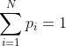
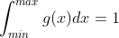
COMPUTING PROBABILITIES:
We know:

Slide 14
COMPUTING PROBABILITIES: EXAMPLES
Rolling a dice:
What’s the probability to get 1?
P = 1/6
What’s the probability of getting a 1 or 2?
P = p(1) + p(2) = 2/6 = ⅓
What is the probability of getting a 1 or 4 or 6?
P = p(1) + p(4) + p(6) = 3/6 = ½
What is the probability of getting a number less than 5?
P = p(1) + p(2) + p(3) + p(4) = 4/6 = 2/3

Slide 15
COMPUTING PROBABILITIES: EXAMPLES
Getting a value of counts smaller than 3 for a variable that follows a Poisson distribution:

Slide 16
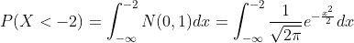
COMPUTING PROBABILITIES: EXAMPLES
Getting any value of count smaller than -2 for a variable that follows a Normal distribution:
Fortunately, we don’t need to compute this, scipy.stats has those values for many continuous probability distributions.
scipy.stats.norm.ppf()

Slide 17

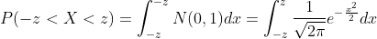
COMPUTING PROBABILITIES FOR THE NORMAL
Given a normal distribution, we can also be interested in knowing how big or small can be a value for which we have a given amount of probability.
Use the symmetry of the distribution in your favor.

Slide 18
STATISTICAL TESTS TYPES:
The one sample statistical tests can be broadly classified into:
One tailed test
Two tailed test
One-tailed hypothesis tests are also known as directional and one-sided tests because you can test for effects in only one direction
Two-tailed hypothesis tests are also known as nondirectional and two-sided tests because you can test for effects in both directions.

Slide 19
STATISTICAL TESTS SAMPLE SIZE:
If the sample size is smaller than 30: use the t-Student distribution with setting number of degrees of freedom = sample_size - 1
Otherwise you can safely use the normal distribution.
Both distributions are symmetric around the center 0.
The t-Student distribution is more spiked at the center and it has longer tails.
When the sample_size is large, both distributions are almost identical.

Slide 20
ONE SAMPLE ONE TAILED TEST:
How big can be a value in order to a given amount of probability to get any value smaller or equal to it for a normal distribution?
1- α
α

Slide 21
EXAMPLE: ONE SAMPLE, ONE TAILED TEST
Boys of a certain age are known to have a mean weight of μ = 85 pounds.
A complaint is made that the boys living in a municipal children's home are underfeed. (μ < 85 pounds)
A sample of n = 25 boys (of the same age) are weighed and found to have a sample mean weight of 80.94 pounds.
It is known that the population standard deviation σ is 11.6 pounds
Based on the sample, can we say that the boys have a mean weight smaller than 85 pounds?
Our sampling error is (80.94 - 85) = -4.06 pounds. How likely is to get this value?

Slide 22
EXAMPLE: ONE SAMPLE, ONE SIDED TEST
What are we trying to establish here?
Contrast (provide enough evidence) the null Hypothesis H0: μ = 85 pounds.
However, we do not have the complete data from the population.
Therefore, we take a SAMPLE of 25 subjects < 30.
Small sample sizes follow a t-student distribution with n - 1 degrees of freedom
The number of degrees of freedom บ is: n - 1 (sample size - 1, 24 in this case)
So based on this sample data we will try to prove or disprove our Hypothesis, using a statistical test.

Slide 23
EXAMPLE: ONE SAMPLE, ONE SIDED TEST
Steps for solving this problem:
Step1: Define the null hypothesis - This is our assumption about the population. It is defined by H0 and in this case H0: μ = 85
Step 2: Define the alternative hypothesis- This means, what if our assumption is not true, inf fact the value is smaller.. It is defined by Ha and in this case Ha: μ < 85

Slide 24
EXAMPLE: ONE SAMPLE, ONE SIDED TEST
Since in this case, our null hypothesis would be false on either side of Ha, hence such a test is called a One sided Test, ie Ha: μ < 85, H0 is false
Step 3: Decide a test statistic based on the information available. As the sample size is small ( n < 30 ), we will use a statistic for a t-Student distribution.
Step 4: Set the Confidence level / significance level: This defines the rejection region / critical region (How strong has to be the evidence against the null hypothesis). Significance level is defined by greek letter ‘α’. Usual values for confidence level are ( 90%, 95%, 99%) -> significance levels = (0.10, 0.05, 0.01). Let’s use a confidence level of 95% -> α = 0.05

Slide 25
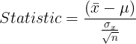
EXAMPLE: ONE SAMPLE, ONE SIDED TEST
Step 5: Calculate the test statistic based on the given information:
Yes
No
If you don’t have the population standard deviation, use the corrected sample standard deviation
Is the statistic within the
acceptable region?
Accept Ho (null hypothesis)
Reject Ho (null hypothesis)

Slide 26
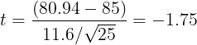
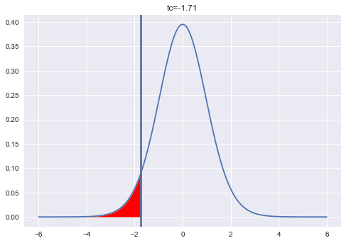
EXAMPLE: ONE SAMPLE, ONE SIDED TEST
In our case:
Where is located the critical value of the t-student distribution with 24 degrees of freedom and an area of 0.95? -> tc = 1.71
tc = +- scipy.stats.t.ppf(0.95, df=24)
Our t = -1.75 < - 1.71=tc-> reject null hypothesis
Children are underfeed.
Unshaded area = 0.95

Slide 27
BIGGER SAMPLE SIZE: ONE SAMPLE, ONE TAILED TEST
Boys of a certain age are known to have a mean weight of μ = 85 pounds.
A complaint is made that the boys living in a municipal children's home are underfeed. (μ < 85 pounds)
A sample of n = 50 boys (of the same age) are weighed and found to have a sample mean weight of 80.94 pounds.
It is known that the population standard deviation σ is 11.6 pounds
Based on the available data, what should be concluded concerning the complaint?

Slide 28
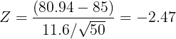
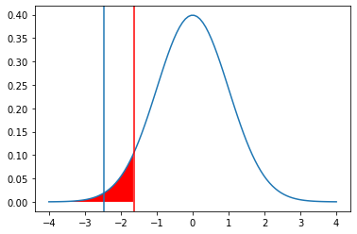
EXAMPLE: ONE SAMPLE, ONE TAILED TEST
In our case:
Where is located the critical value of the normal distribution with an area of 0.95? -> zc = 1.64
zc = +- scipy.stats.norm.ppf(0.95)
Our z = -2.47 < - 1.64 = zc -> reject null hypothesis
Children are underfeed.

Slide 29
EXAMPLE: ONE SAMPLE, TWO TAILED TEST
Boys of a certain age are known to have a mean weight of μ = 85 pounds.
A complaint is made that the boys living in a municipal children's home have a different average weight. (μ != 85 pounds)
A sample of n = 25 boys (of the same age) are weighed and found to have a sample mean weight of 80.94 pounds.
It is known that the population standard deviation σ is 11.6 pounds
Based on the available data, what should be concluded concerning the complaint?

Slide 30
ONE SAMPLE, TWO TAILED TEST
Two-tailed test is a method to tests whether a sample is greater than or less than a certain range of values.
Ex:
Null Hypothesis: Ho -> μ = 85 pounds
Alternate hypothesis: Ha -> μ != 85 pounds

Slide 31
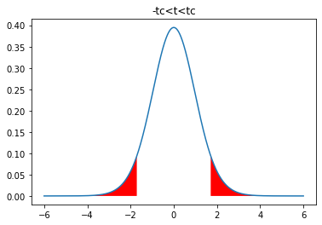
EXAMPLE: TWO SIDED TEST
Acceptance
region
Now, our value can be bigger or smaller than the population value. Therefore, the “rejection region” has to be shared at both sides!
α/2
1-α
α/2
Where are the vertical bars located?

Slide 32
EXAMPLE: ONE SAMPLE, TWO SIDED TEST
Step 5: Calculate the test statistic based on the given information:
Yes
No
If you don’t have the population standard deviation, use the corrected sample standard deviation
Is the statistic within the
acceptable region?
Accept Ho (null hypothesis)
Reject Ho (null hypothesis)

Slide 33
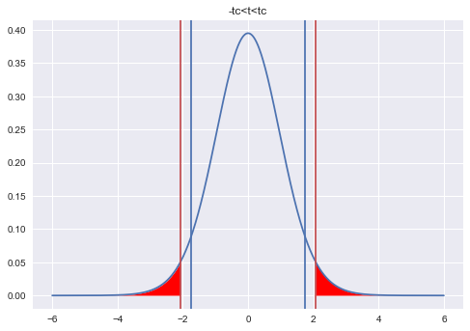
EXAMPLE: ONE SAMPLE, TWO SIDED TEST
In our case:
Where is located the critical value of the t-student distribution with 24 degrees of freedom and an area of 0.95? -> tc = 2.06
tc = +-scipy.stats.t.ppf(1-(0.05/2)=0.975,df=24)
Now, tc = -2.06 < -1.75 = t-> accept null hypothesis
Children have the mentioned average weight.

Slide 34
EXAMPLE: ONE SAMPLE, TWO TAILED TEST
Boys of a certain age are known to have a mean weight of μ = 85 pounds.
A complaint is made that the boys living in a municipal children's home are underfeed. (μ != 85 pounds)
A sample of n = 50 boys (of the same age) are weighed and found to have a sample mean weight of 80.94 pounds.
It is known that the population standard deviation σ is 11.6 pounds
Based on the available data, what should be concluded concerning the complaint?

Slide 35
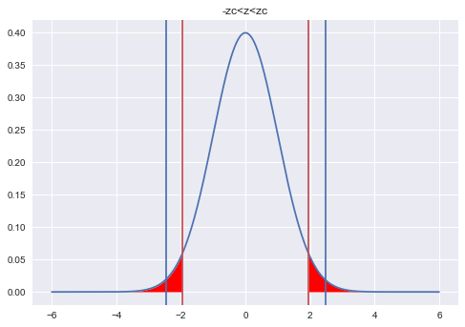
EXAMPLE: ONE SAMPLE, ONE SIDED TEST
In our case:
Where is located the critical value of the normal distribution with an area of 0.95? -> zc = 1.96
zc = +-scipy.stats.norm.ppf(1-(0.05/2)=0.975)
Now Zc = -1.96 > Z= - 2.47 -> reject null hypothesis
Children don’t have the mentioned weight.

Slide 36
IRONHACK BOOTCAMP
CONFIDENCE INTERVALS FOR A POPULATION MEAN
Every sample we take will give us a different sample mean which is different from the population mean.
A confidence interval is range of values around our sample mean that is highly likely to contain the population mean.
Knowing that the sampling distribution ( the distribution of the means of many samples ) follows a normal distribution, we can provide such range of values as:
We can compute this using scipy.stats.norm.interval() and scipy.stats.t.interval()

Slide 37


